Slide 1

DEAListic
김준현 모하메드(대현) 유도영 최지혜 허준범
Team #5 Project Proposal

Slide 2
#01
Background
#02
Project Overview
#03
Design Concept
#04
Development
#05
Features
References

Slide 3
Background
#01

Slide 4
User Reviews
#01
Background

Slide 5
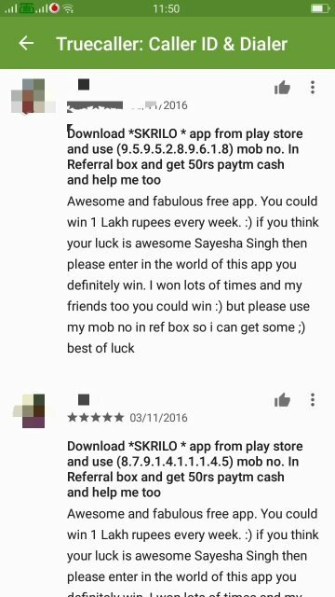
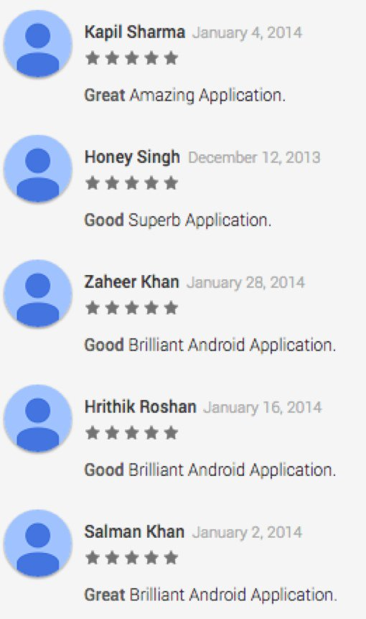
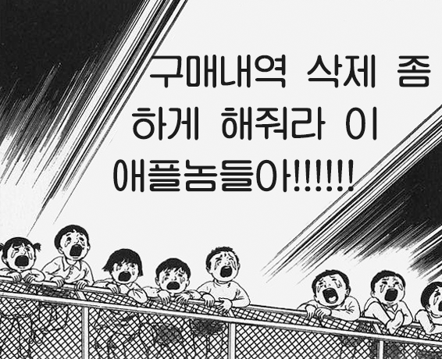
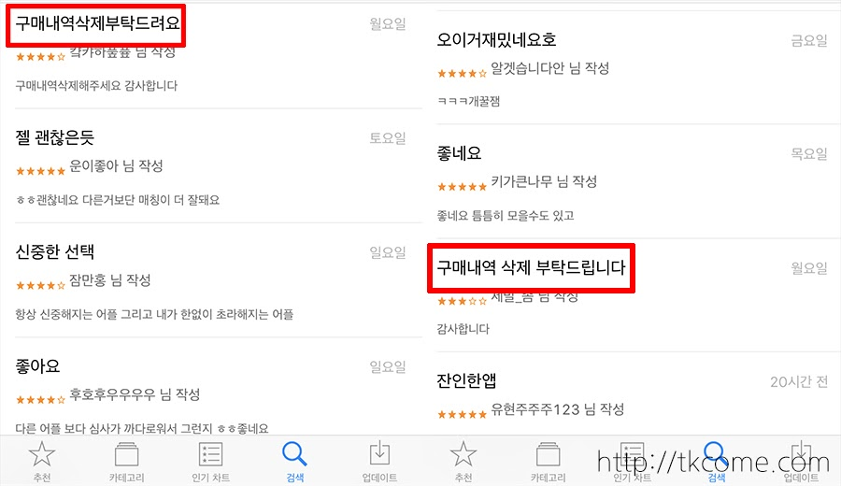
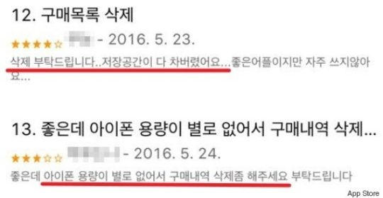
User reviews are NOT reliable
#01
Background

Slide 6
We need to evaluate products
more informatively
#01
Background

Slide 7
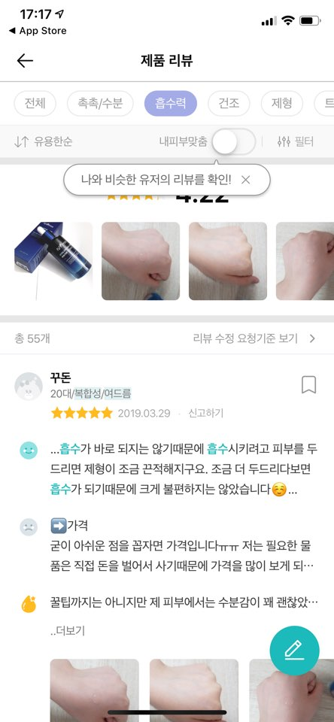
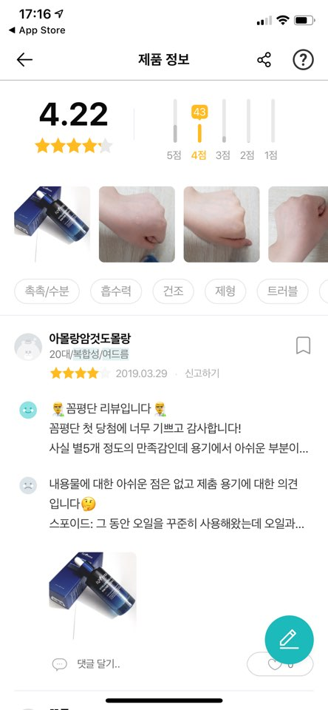
Case Study:
‘Hwahae’ – Cosmetic App
shows many mentioned keywords
at top of product page
extracts keywords
from actual user reviews
#01
Background

Slide 8
Project Overview
#02

Slide 9


Why ‘Dealistic’?
Dealistic
Make a deal
Get realistic reviews
#02
Project Overview

Slide 10



Our Goals
Extract
meaningful info from reviews
Show
realistic rating and characteristic
Recommend
based on user’s interest
#02
Project Overview

Slide 11

Data Mining
:Process of discovering patterns in large data sets
#02
Project Overview

Slide 12
Design Concept
#03

Slide 13
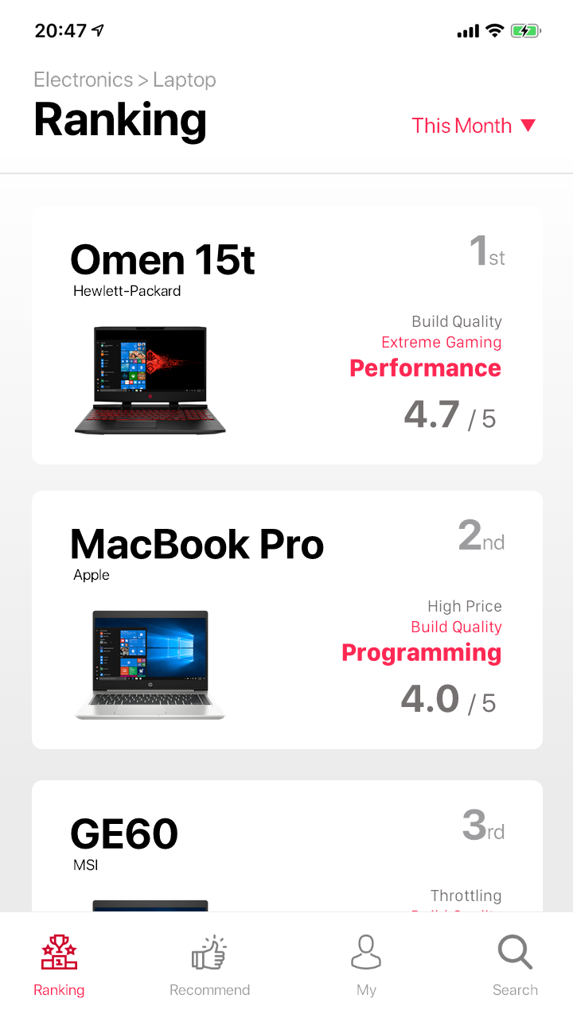
Ranking
User can change search criteria
Display main keywords
based on user reviews
Move to detailed view
If click each entry
Review scores also shown
#03
Design Concept

Slide 14
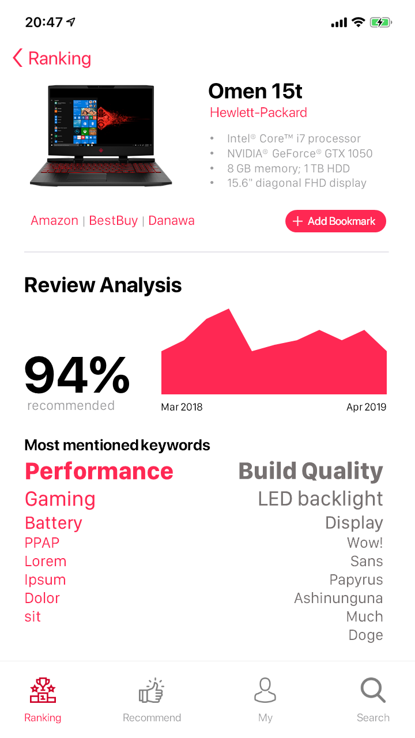
Item Detail
Show item details
Links to Resellers
User can add item into bookmark
Annual score graph is shown
Show detailed review scores
Show most mentioned keywords
based on user review articles
Keywords are classified by sentiment (positive or negative)
#03
Design Concept

Slide 15
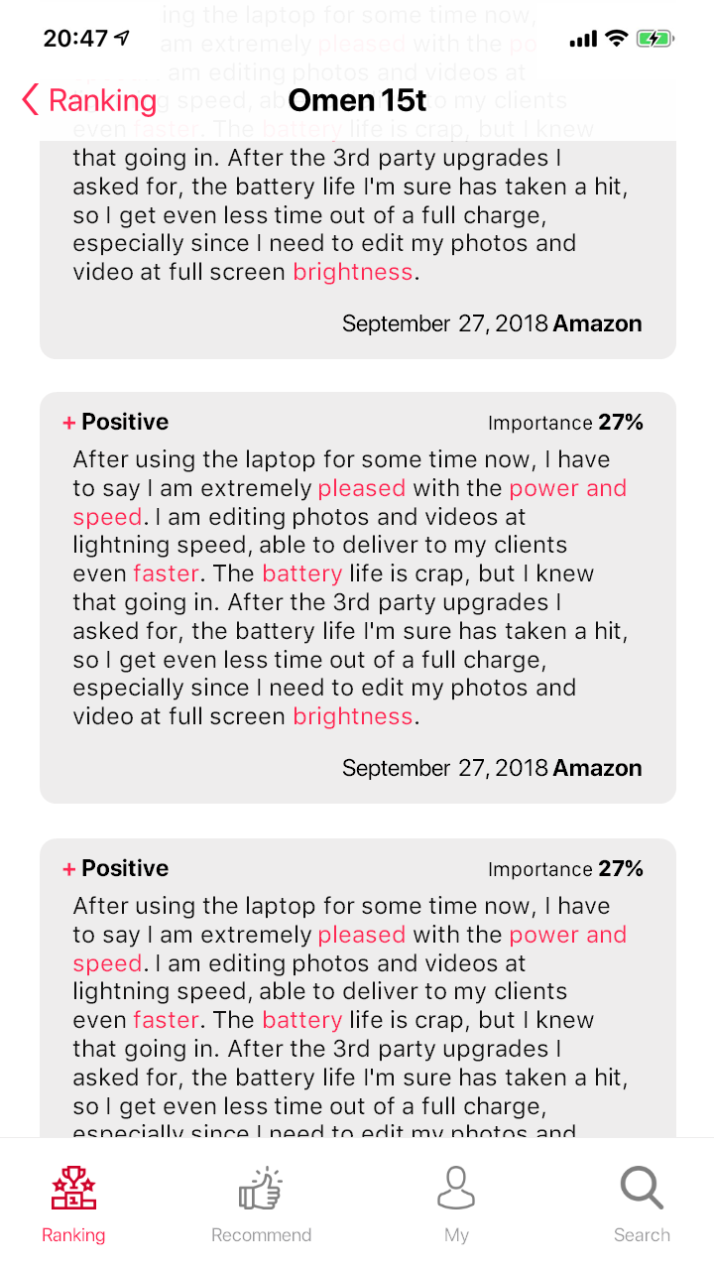
Item Detail
Review Reference
Show sentiment of
each review
Show importance of
each review
Highlight keywords
#03
Design Concept

Slide 16
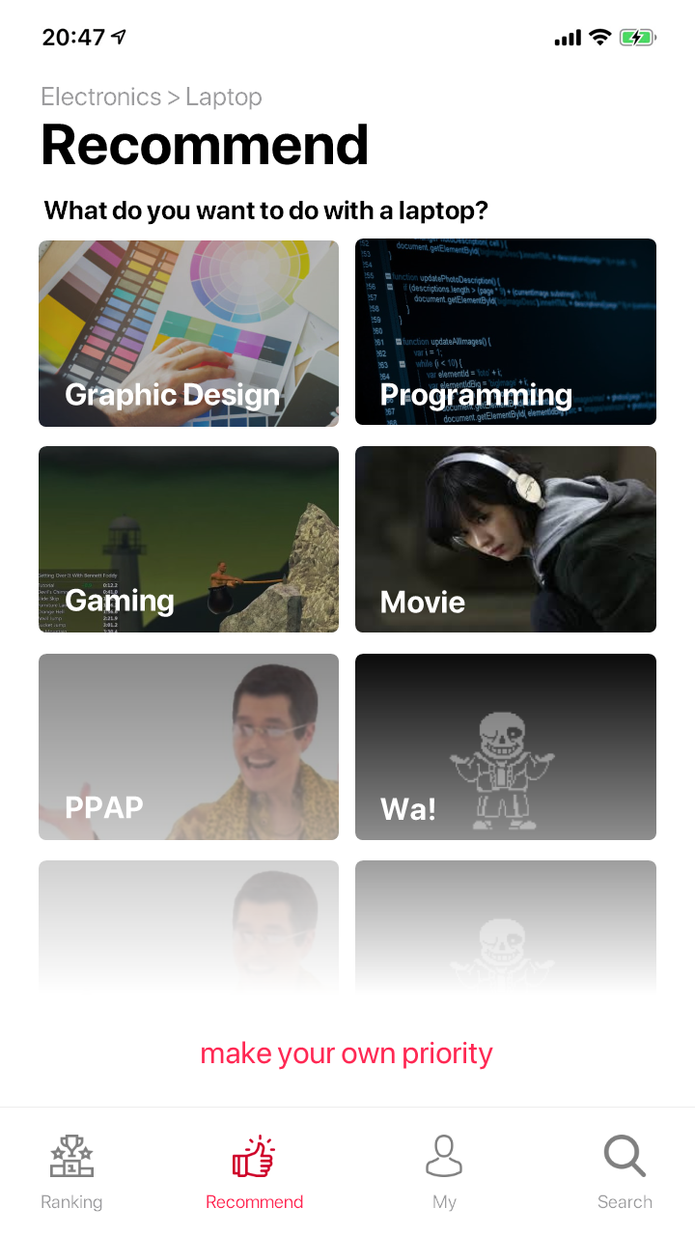
Recommendation
Move to recommendation page
If click each entry
Each interest contains
several requirements and constraints
User can make their own priority for recommendation
#03
Design Concept

Slide 17
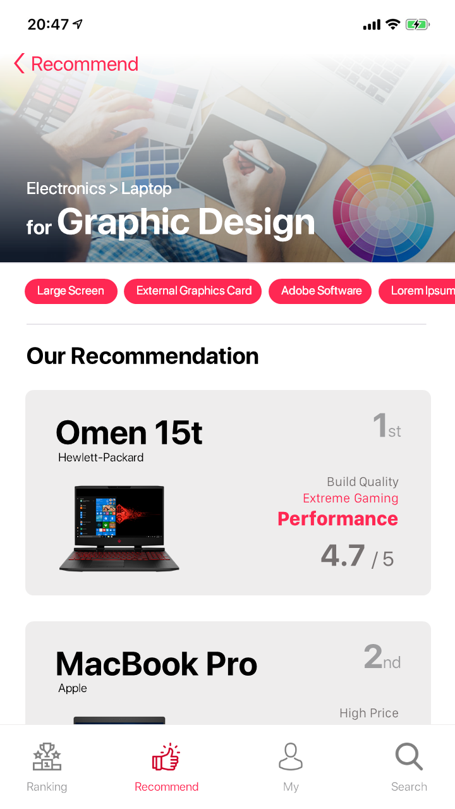
Recommendation
Show all requirements and constraints included
(swipe to see more)
Recommendation shown
#03
Design Concept

Slide 18
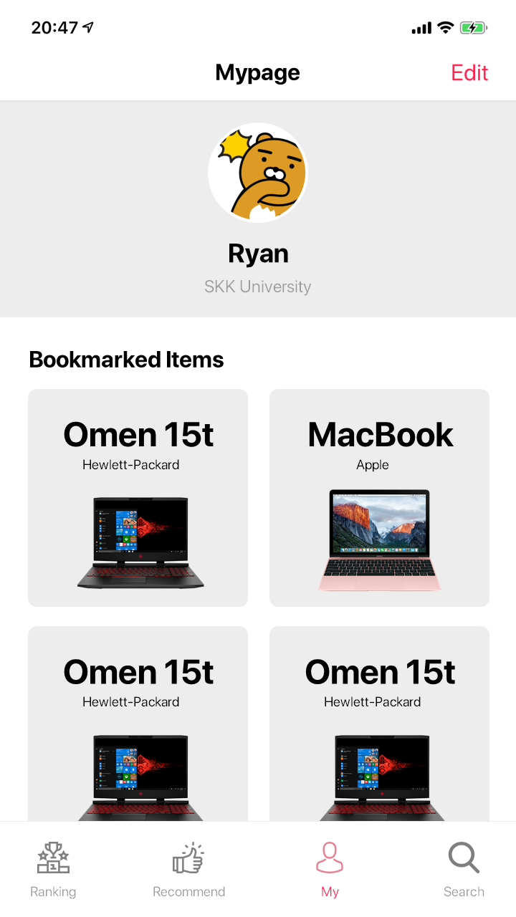
Mypage
User’s profile is shown
Bookmarked item list
#03
Design Concept

Slide 19
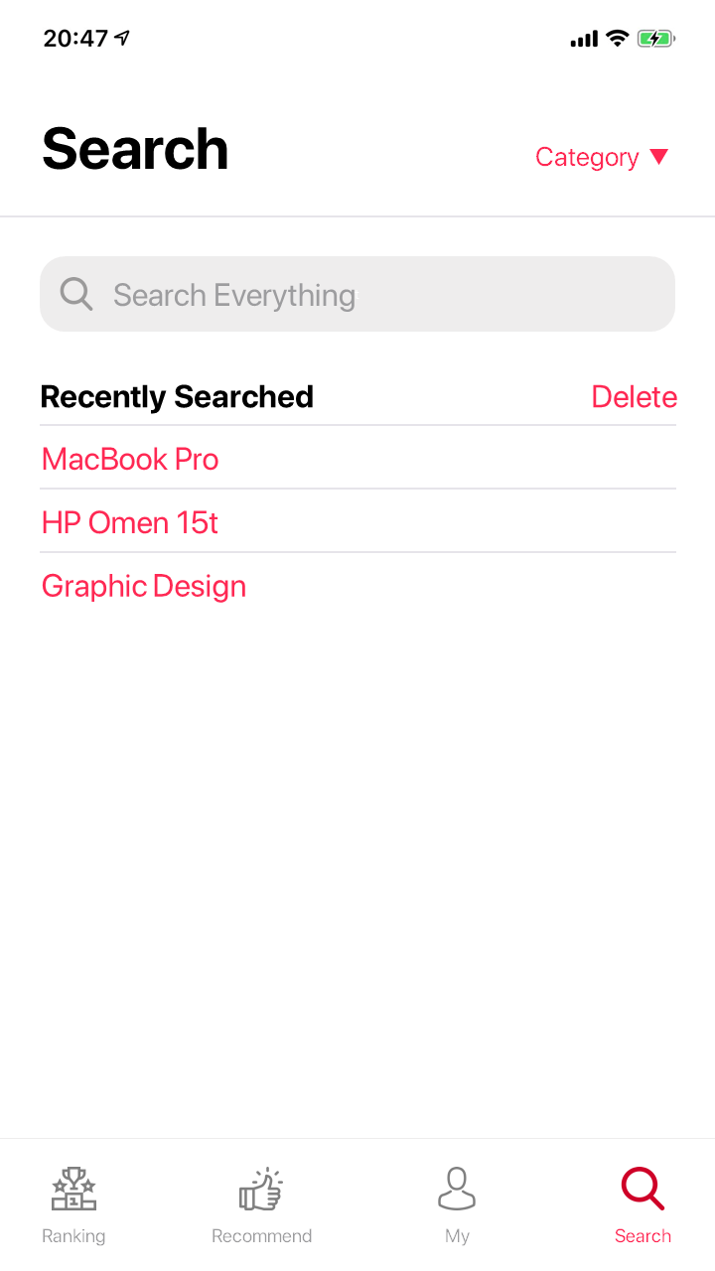
Search
Can change search category
Search bar
Recently searched history is shown
#03
Design Concept

Slide 20
Development
#04

Slide 21
System Structure
System
Frontend
Backend
Web Application Server (WAS)
Database
Review Rating System
Pre-processor
Review Analyzer
Rating Updater
with
#04
Development

Slide 22






Using Technology
Frontend
Backend
#04
Development

Slide 23
Using Technology
Frontend
Vue.js
PWA
D3.js
Progressive Web App
JavaScript Frontend Framework
Data Visualization Library
No need to install
Fast development
Good integration with node.js backend
HTML-like Template
Easy to convert to PWA
Used for keyword visualization
#04
Development

Slide 24
Using Technology
Backend
Heroku
API call
Server Hosting
Node.js
MySQL
Google Cloud
Database Management System
JavaScript-based
Server Framework
Natural Language API
Most common DBMS tool
Used for keyword analyzation
Lightweight
Good developer ecosystem
#04
Development

Slide 25
Development Schedule
Based on incremental model
Specification
Development
Integration
Acceptance
Test
~Week 9
~Week 13
~ Final Presentation
#04
Development

Slide 26
Effects and Benefits
#05

Slide 27
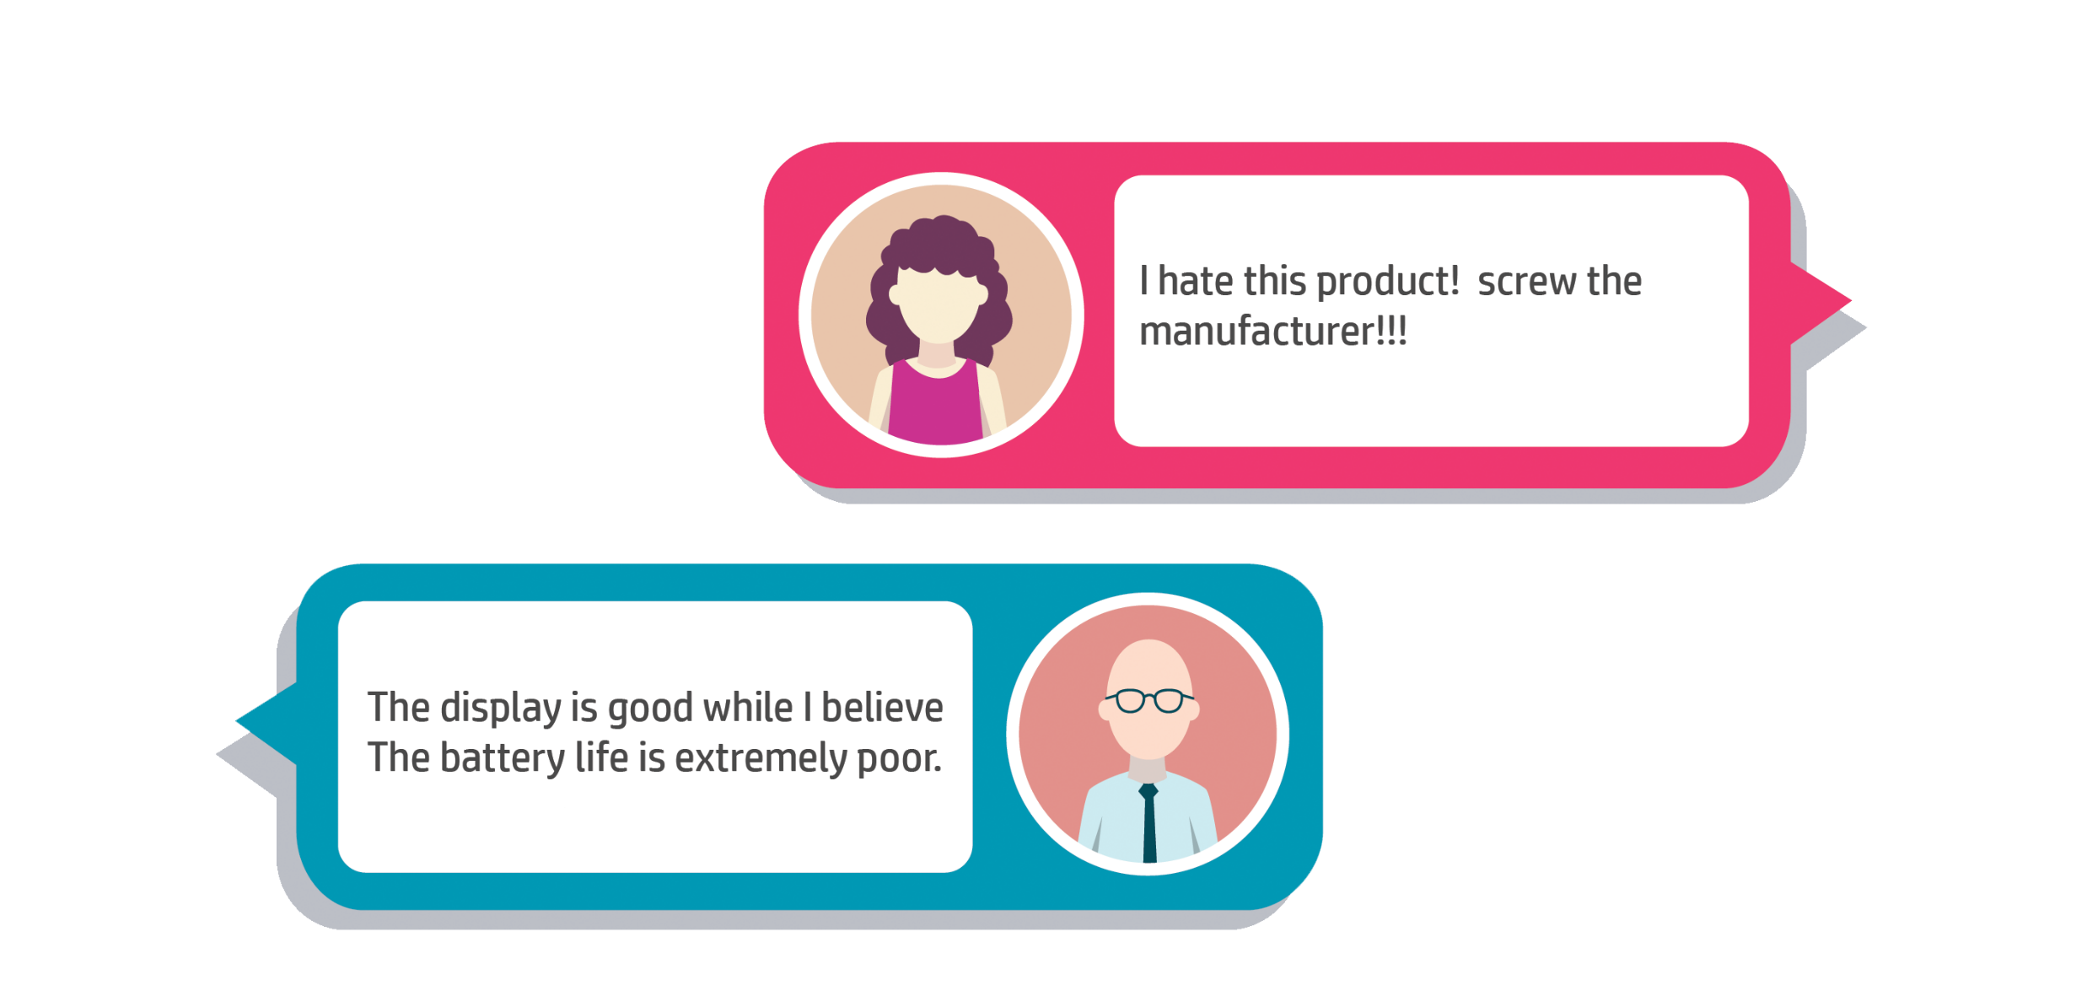
Benefits
Low Weight ↓
↑ High Weight
Unbiased & Precise review
based on
weightage of the sentence structure
existence of keywords
#05
Effects and Benefits

Slide 28

Benefits
Help decision
what to buy or not
#05
Effects and Benefits

Slide 29
Reference
https://www.flaticon.com/
https://kr.vuejs.org/v2/guide/index.html
https://responsivedesign.is/news/2018/08/pwa-progressive-web-all-the-things/pwa-progressive-web-app-logo/
https://d3js.org/
https://cloud.google.com/
https://nodejs.org/ko/
https://www.mysql.com/
https://www.heroku.com/

Slide 30
Thank you
Q&A

